Slide 1

Google Data analytics capstone project
S Shivani 12/02/2025

Slide 2
Track 2.
Is Bitcoin a good investment?
Bitcoin is a decentralized digital currency where the transactions take place between users directly without an intermediary and are verified by network nodes through cryptography and finally recorded in a public distributed ledger called blockchain.

Slide 3
Framework overview
1. Ask
Understand the problem
Ask the right question.
2. Prepare
•Collecting Data •Verify Data
3. Process •Create clean data •Recheck data
4. Analyze •Identify trends and relationships •Organize and format data
5. Share •Create Visualization •Present findings
6. Act •Share next steps •Evaluate

Slide 4
1. ask
Our objective is to analyze Bitcoin's historical performance and assess its investment potential.
Some questions we want to answer :
What are the key metrics for evaluating Bitcoin's performance?
How does Bitcoin's performance compare to traditional investments like stocks and gold?
What risks are associated with investing in Bitcoin?

Slide 5
2. prepare
The data sources we used are :
Bitcoin Historical Data (https://www.kaggle.com/datasets/mczielinski/bitcoin-historical-data)
Gold Prices (https://www.kaggle.com/datasets/tunguz/gold-prices)
Facts about data :
Bitcoin Historical Data: CSV files for select bitcoin exchanges for the time period of Jan 2012 to Present
Gold Prices: Historical Annual Gold Prices. Retrieved from DataHub, and expected to be updated annually.

Slide 6
3. Process
Here we are using two datasets :
Bitcoin Dataset:
Columns with missing values: Checked for missing values in open, high, low, close, volume, and timestamp.
Strategy:
Filled missing values in open, high, low, and close with the median to avoid the influence of outliers.
Filled missing values in volume with the mean for consistent handling of continuous data.
Dropped rows with missing timestamp.
Gold Dataset:
Columns with missing values: Checked for missing values in price and date.
Strategy:
Filled missing values in price with the median.
Dropped rows with missing date.

Slide 7
3. Process
Here we are using python for data exploration and reporting.
Outcome:
Both datasets are now complete and ready for further analysis.
For more details refer to

Slide 8
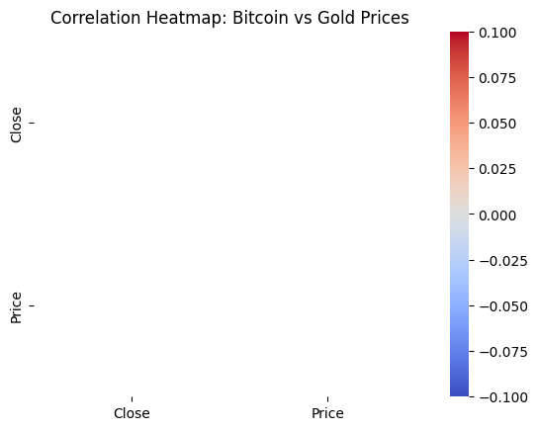
4. Analyze
Analysis is done using python and can be found in this link
Some notable findings are :
Bitcoin price trends:

Slide 9
4. Analyze
Gold price trends:

Slide 10
4. Analyze
Volatility Comparison (Daily % Change) :

Slide 11
4. Analyze

Slide 12
5. Share
Based on our thorough analysis, we will go back to our original question and try to answer them.
What are the key metrics for evaluating Bitcoin's performance?
→ Price trends, volatility, trading volume, and historical returns.
How does Bitcoin's performance compare to traditional investments like stocks and gold?
→ Bitcoin is more volatile and high-risk, while Gold is more stable but has lower returns.
What risks are associated with investing in Bitcoin?
→ High price fluctuations, regulatory uncertainty, and market speculation.

Slide 13
6. act
Recommendations:
Bitcoin can be a good investment for high-risk tolerant investors.
Diversify your portfolio with other assets to minimize risk.
Based on the analysis of Bitcoin and Gold prices, we can draw actionable insights for investors and stakeholders. Bitcoin exhibits high volatility, making it a risky but potentially high-reward investment, whereas Gold remains a stable store of value with lower fluctuations. The correlation analysis shows that Bitcoin and Gold have little to no strong relationship, meaning they behave independently as assets. Investors looking for long-term stability may prefer Gold, while those seeking high returns and are willing to accept risk might consider Bitcoin.

Slide 14
THANKYOU!

